Slide 1
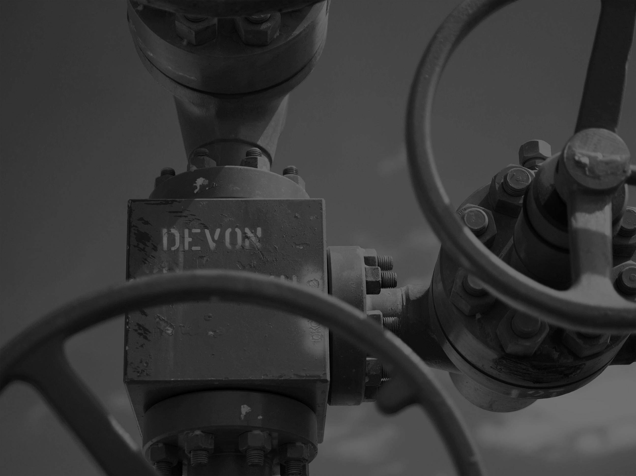
Pipe Measurement Tubing Tally Problem
-Praveen Pandey, Adrian Bustamante, Andrew Fine, Girish Dwivedi & Connor Sinclair

Slide 2
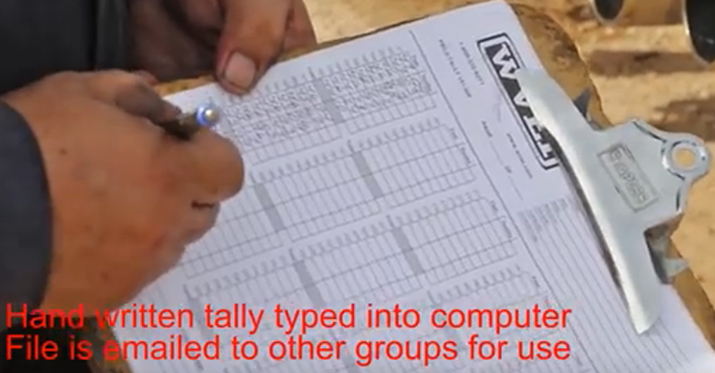
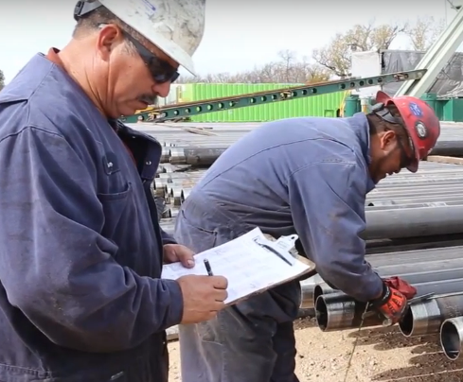
Business Problem
Today, capturing information about tubing and casing before placing it downhole is a laborious and inefficient process.
Information captured is taken in a series of disconnected manual processes
Requires 3 people to complete measurement task
4th person required for manual data entry
Risk of data quality issues
Processing time is long and data quality is reduced
In Sum - measurement process requires too many people and too much time.

Slide 3
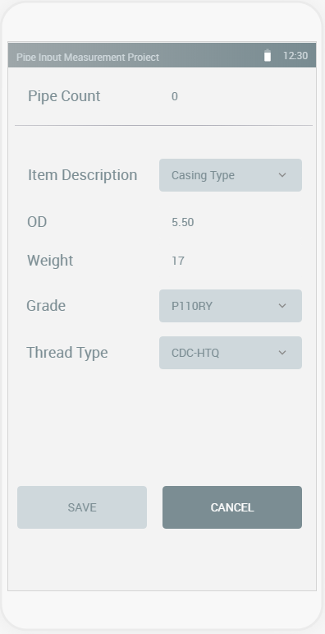
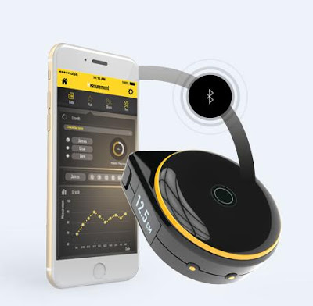
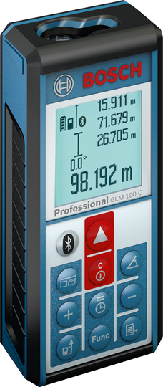
Solution Breakdown
Custom mobile application for logging pipe data and aggregating with measurements
Application requires minimal manual input and can be synced with a database
Improved pipe measurement device

Slide 4
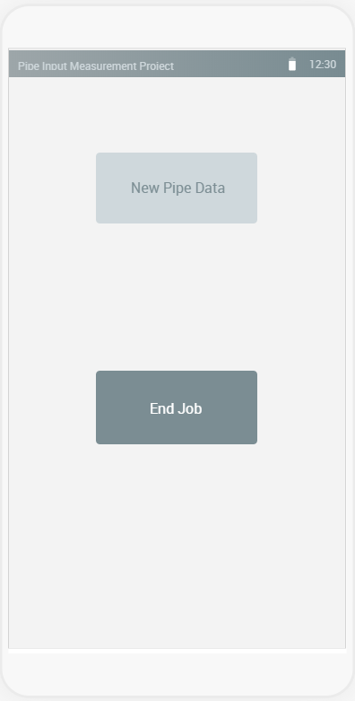
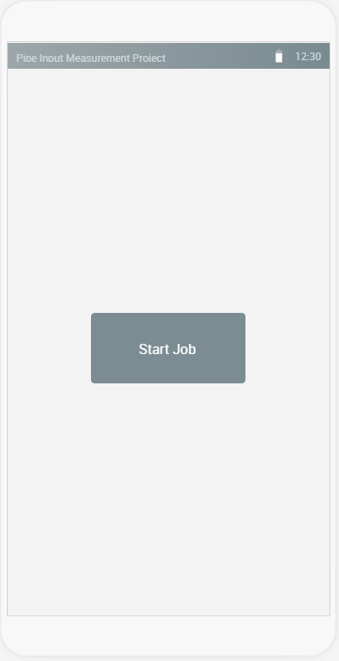
Custom Mobile Application

Slide 5
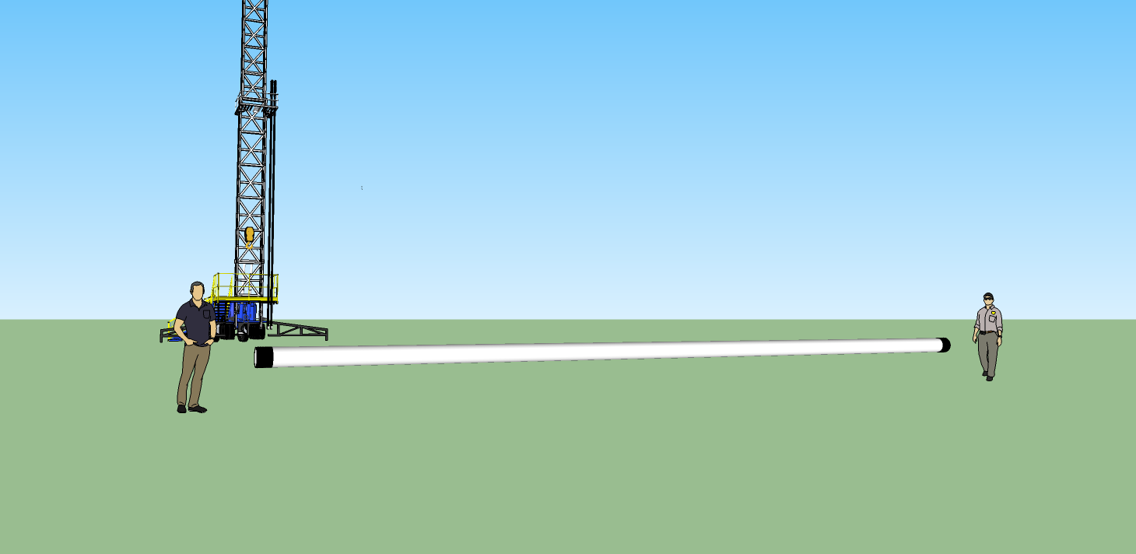
Short – Term Solution

Slide 6
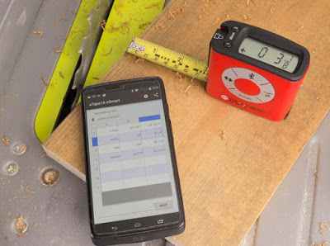
Short – Term Solution
Equipment Required
Electronic tape measure
Mobile app connected via Bluetooth
Steps
User opens app
Connect to device
2 people working the measuring tape
Measurement CSV file created in app
Export to device
Custom app ingests and aggregates with pipe paramaters

Slide 7
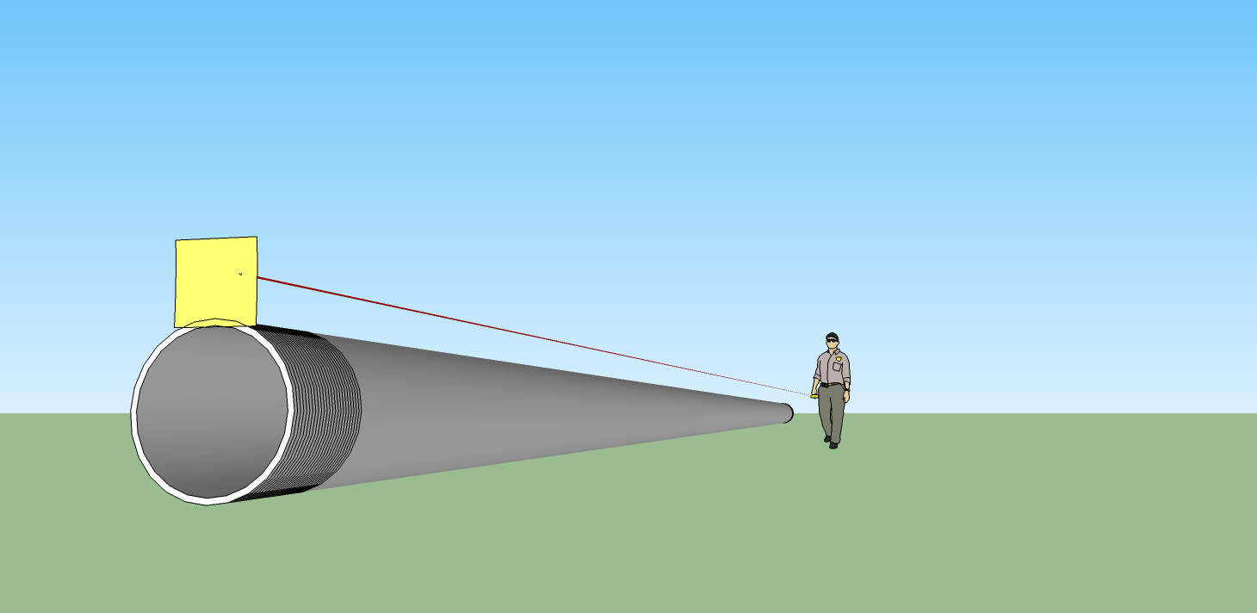
Long – Term Solution

Slide 8

Long – Term Solution
Equipment Required
Field ready laser measurement system
Mobile app connected via Bluetooth
Steps
User opens app
Connect to laser
1 person fits end tag on pipe openings
Then uses laser to take measurements
Measurement CSV file created in app
Custom app ingests and aggregates with pipe paramaters

Slide 9
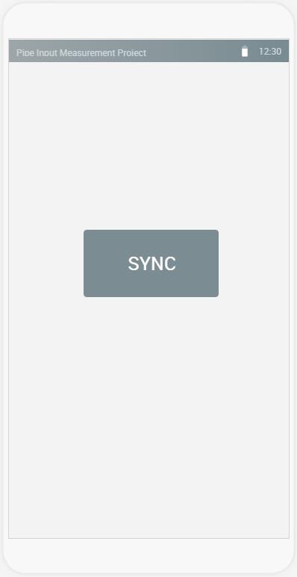
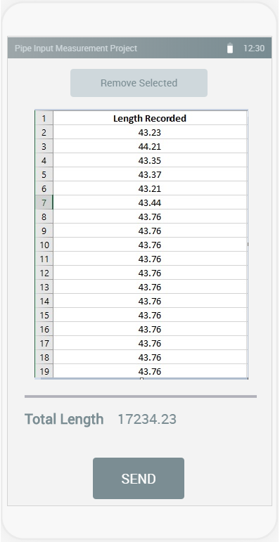
Custom Mobile Application

Slide 10
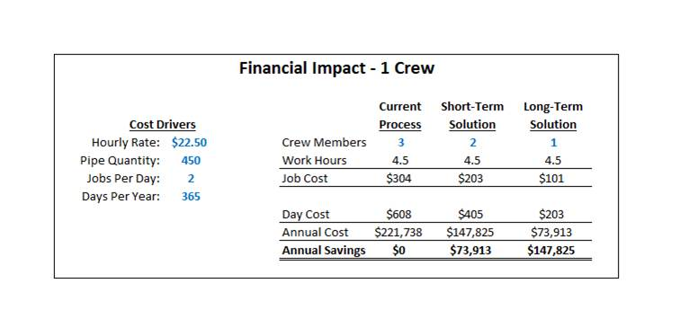
Financial Impact

Slide 11
try
{
audience.ask(questions);
}
Catch(Exception e)
{
Console.Writeline (“Hmmmmmm….”);
}

